Slide 1
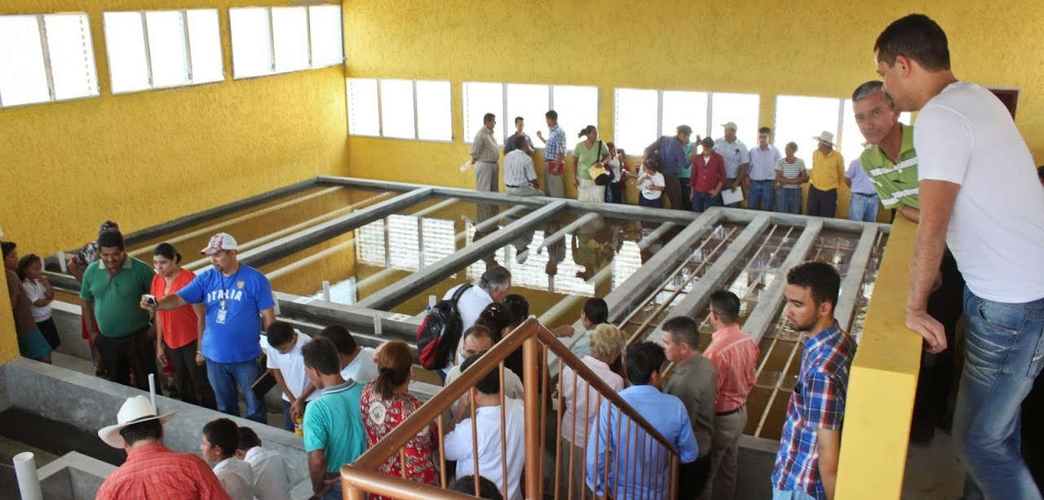
An Elegant Solution for Safe Water on Tap
Monroe Weber-Shirk
Notes:
Add intro to each unit process to help students think about projects

Slide 2
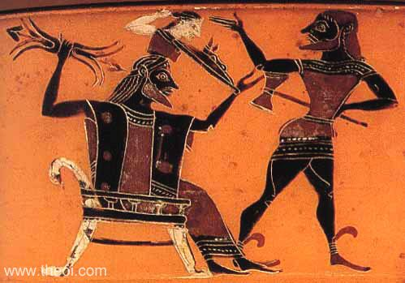


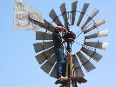

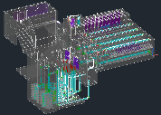
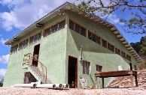
Overview
How to Innovate and Design
The AguaClara Consortium
High-tech and Elegance
Pride of ownership
AguaClara technologies and plants
Philosophy and Reflections
Ctrl + click the pictures to go each section!

Slide 3
Overview
How to Innovate and Design
The AguaClara Consortium
High-tech and Elegance
Pride of ownership
AguaClara technologies and plants
Philosophy and Reflections
Ctrl + click the pictures to go each section!

Slide 4
Three ideas…
Evolution – Iteration – Mistakes - Learning
Water treatment is about the complex interactions between fluids, particles, and geometry (beyond rectangular tanks!)
Success requires understanding the details!
Density currents caused by temperature change
Flow distribution to reduce mean currents
A roof to protect operators and the plant
Notes:
Microbes are awesome particles!

Slide 5
Inventing Perfection
“Furthermore, as the full scale plant is already in operation, the need for further design changes is not clear.” -(Anonymous Reviewer)
Ideas spring fully formed from their creator’s mind?
Athena leaped from Zeus's head, fully grown and armed
http://designserver.cee.cornell.edu/Designs
Notes:
What about iteration and feedback?

Slide 6
Overview
How to Innovate and Design
The AguaClara Consortium
High-tech and Elegance
Pride of ownership
AguaClara technologies and plants
Philosophy and Reflections
Ctrl + click the pictures to go each section!

Slide 7









AguaClara Consortium
R&D
Transfer
Implementers
Operate
Market
Municipalities
Implementers
Water Boards
Implement
Finance
Municipalities

Slide 8
Overview
How to Innovate and Design
The AguaClara Consortium
High-tech and Elegance
Pride of ownership
AguaClara technologies and plants
Philosophy and Reflections
Ctrl + click the pictures to go each section!

Slide 9
Simple, Elegant, or Complicated?
“Any intelligent fool can make things bigger, more complex, and more violent. It takes a touch of genius — and a lot of courage – to move in the opposite direction.” --- E.F. Schumacher
“Simplicity is the ultimate sophistication.” --- Leonardo da Vinci

Slide 10
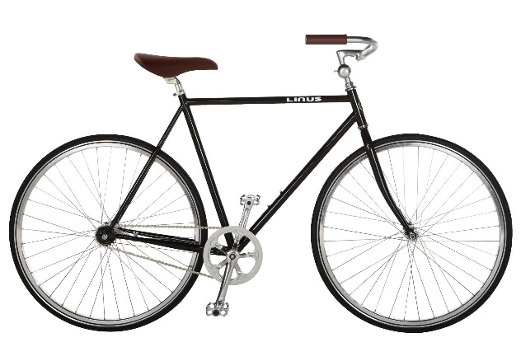

Elegant Solution
Solves the problem very well
No unnecessary complexity
Easy to understand
Simple and beautiful
Bicycle
Windmills
Context matters in defining elegant!

Slide 11
Overview
How to Innovate and Design
The AguaClara Consortium
High-tech and Elegance
Pride of ownership
AguaClara technologies and plants
Philosophy and Reflections
Ctrl + click the pictures to go each section!

Slide 12
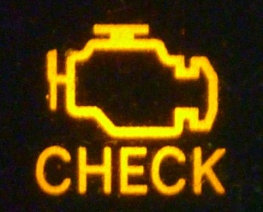
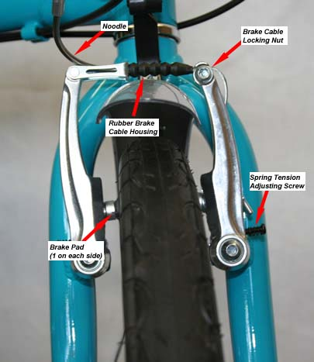

Pride of Ownership
What happens when the check engine light goes on in your car?
What do you do if your bicycle brakes need to be adjusted?
What does the plant operator do if the chemical feed stops working?
We want the plant operator to diagnose and fix the problem without needing to call anyone.

Slide 13
Overview
How to Innovate and Design
The AguaClara Consortium
High-tech and Elegance
Pride of ownership
AguaClara technologies and plants
Philosophy and Reflections
Ctrl + click the pictures to go each section!

Slide 14



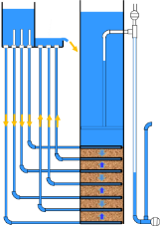
AguaClara Technologies
Chemical dosing
Flocculator
Floc Blanket
Sedimentation
Filtration
Conclusions

Slide 15



Stages of particle removal
Coagulation
Flocculation
Floc Blanket
Sedimentation
Filtration
Nanoparticle deposition
Collisions
More Collisions
Gravity!
Last chance!
Notes:
Here are the five stages of colloid or particle removal in hydraulic drinking water treatment plants. The first stage, coagulation, involves the addition of a chemical coagulant to destabilize a suspension of particles. The coagulant precipitates and attaches to the particle surface. Then in flocculation, velocity gradients in the water cause the particles (now coated in precipitated coagulant) to collide and stick to one another forming aggregates. In floc blankets there are many more opportunities for collisions. In sedimentation, fluid flow is very slow and the aggregates settle to the bottom of the tank. Filtration is often used to remove any remaining particles but is not included in the bench-scale setup.

Slide 16
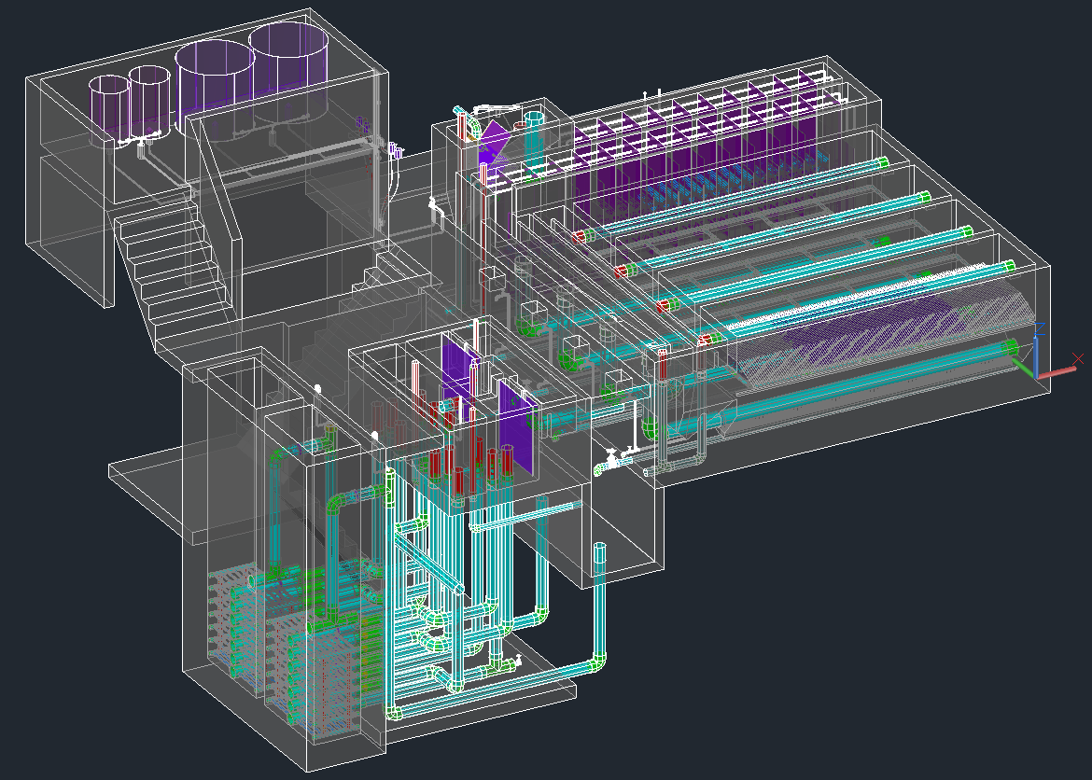
Chemical Dosing
Entrance Tank
Chemical Stock Tanks
Flocculator
Sedimentation
Open Stacked Rapid Sand (OStaRS) Filter
Drain Channel

Slide 17
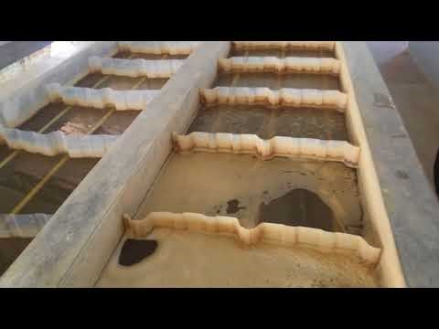
Tour of an AguaClara plant

Slide 18
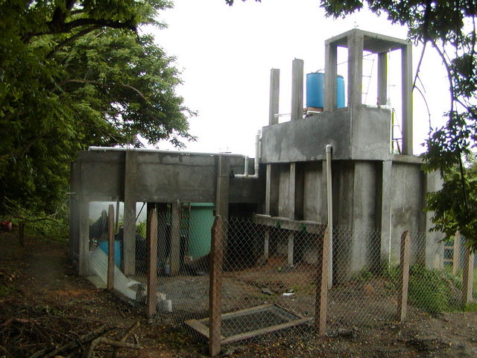
Plant zero
Entrance Tank
Elevated flocculator
Sedimentation Tank

Slide 19
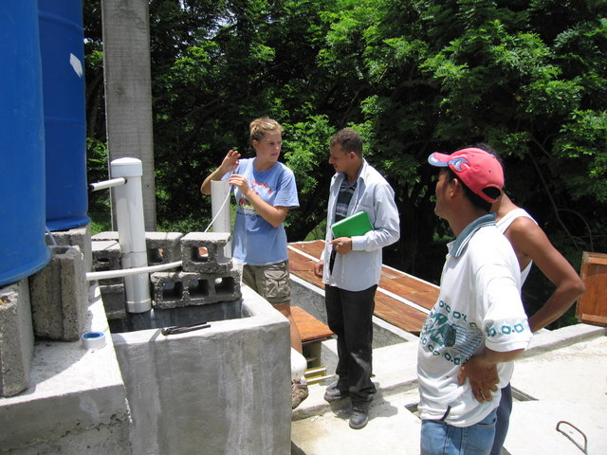

Slide 20
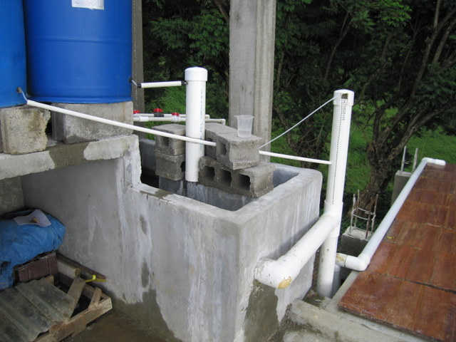
What do you see?
Why did this happen?

Slide 21
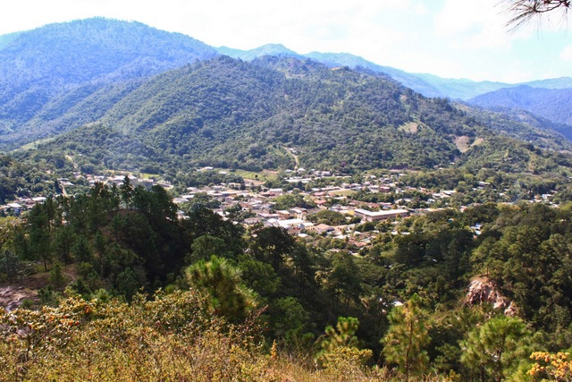
San Nicolas

Slide 22
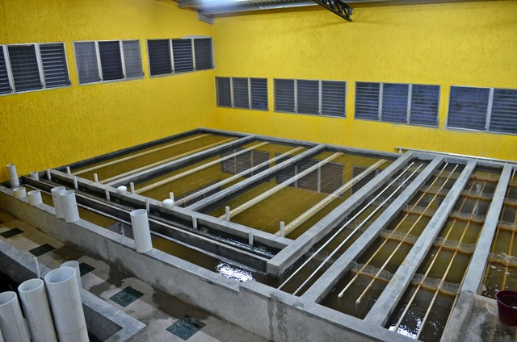

Slide 23
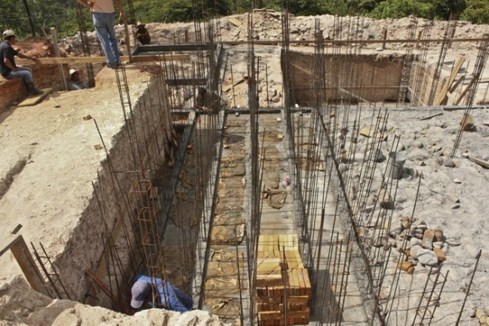
Flocculator Channels

Slide 24
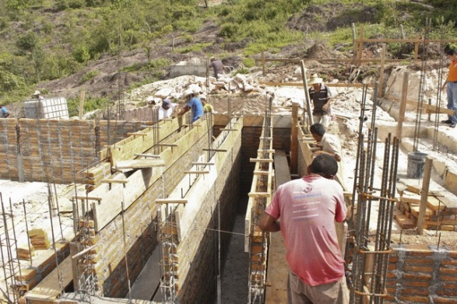

Slide 25
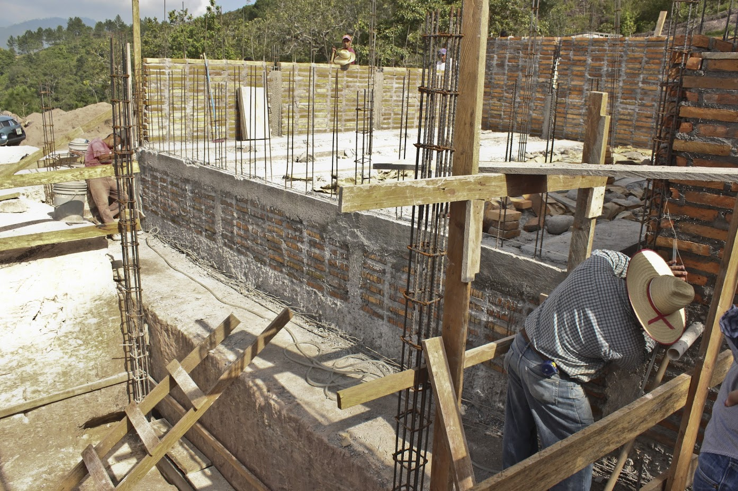
What do you see?

Slide 26
What is the difference between laser level and water level?
Suppose I am building a really big structure…

Slide 27
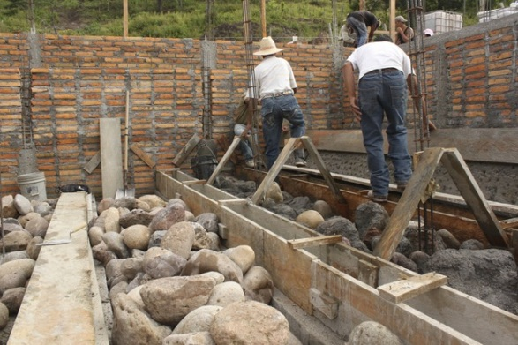

Slide 28
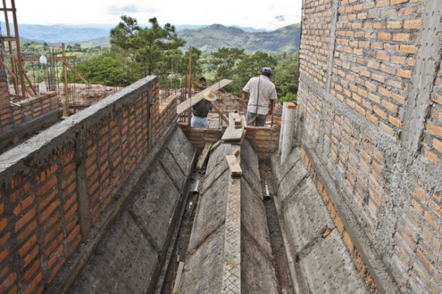

Slide 29
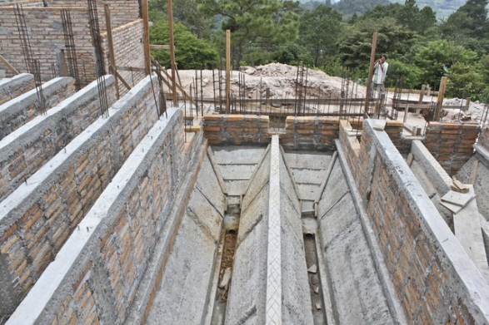

Slide 30
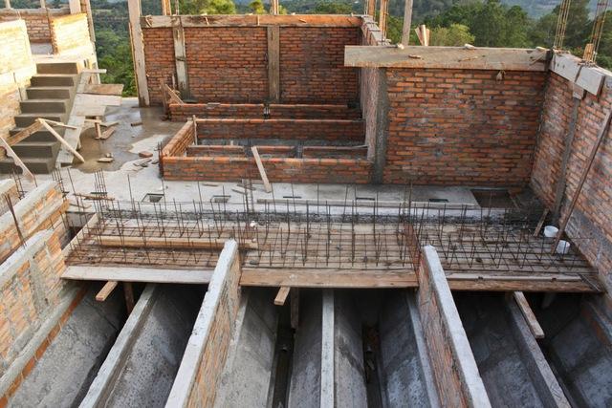

Slide 31
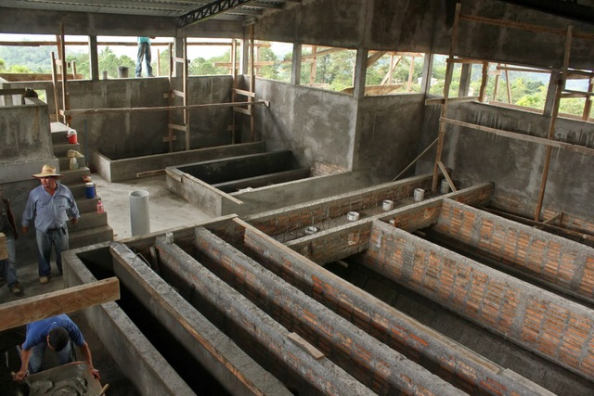
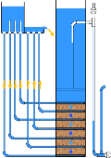


Slide 32
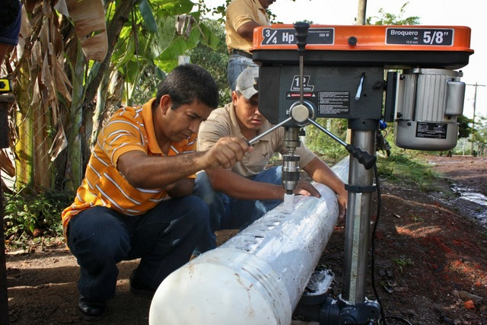

Slide 33
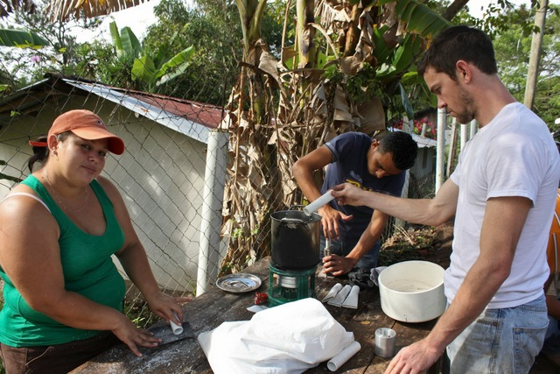

Slide 34
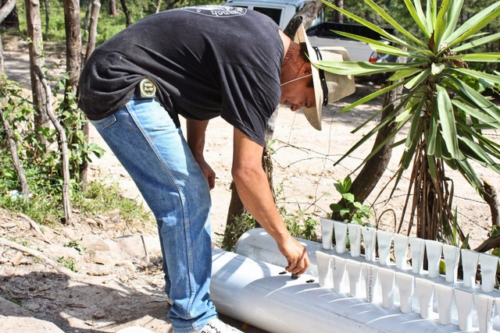

Slide 35
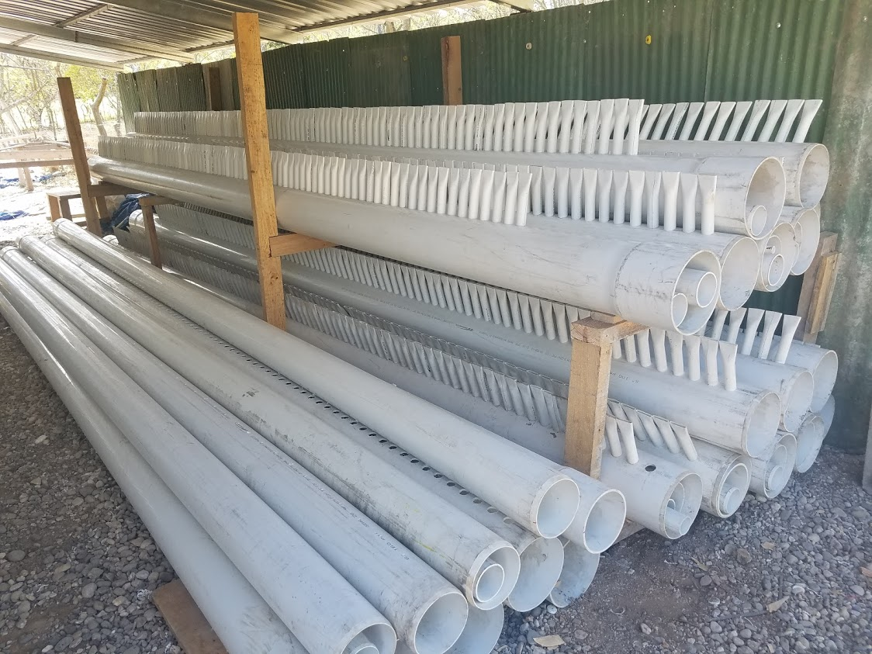

Slide 36
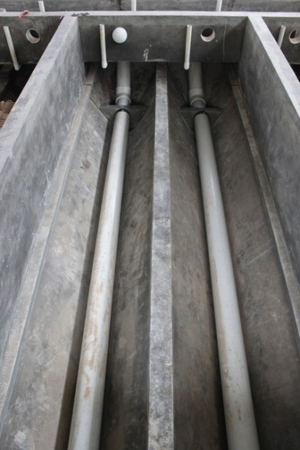

Slide 37
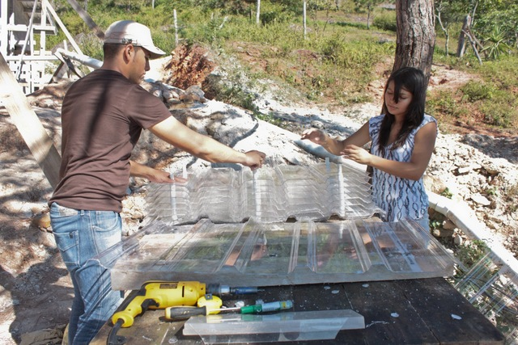

Slide 38
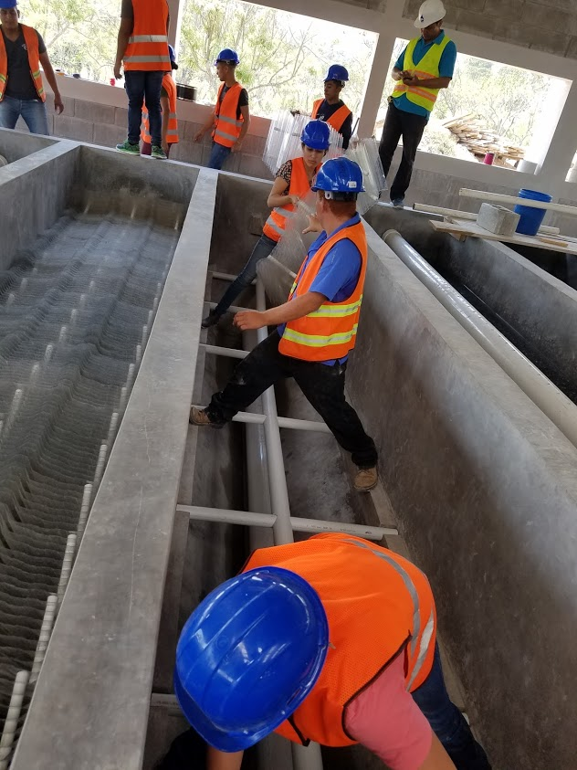

Slide 39
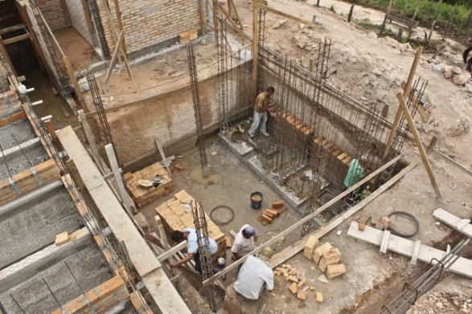

Slide 40
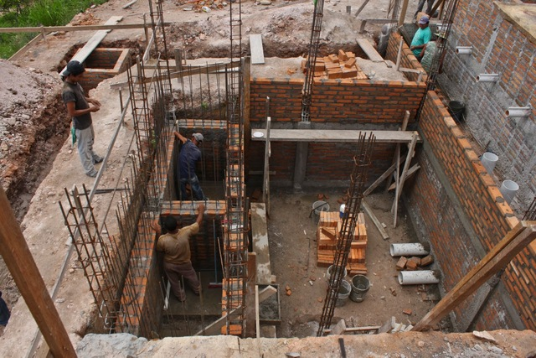
Sludge drains!
Sed tank drains!
Backwash water!
2 Filters
Filter Pipe Gallary

Slide 41
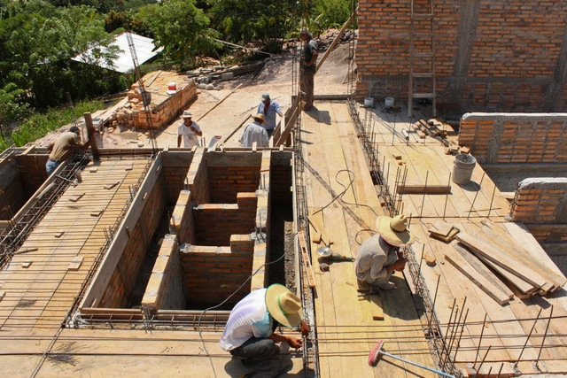
Sed tanks
Sed tank
Inlet and outlet channels
Filter
Filter Inlet
Filter Outlet

Slide 42
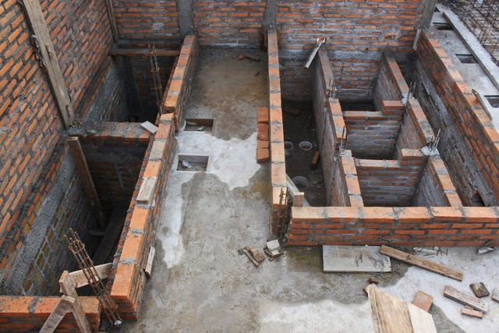
Filter Inlet
Filter Outlet
Filters

Slide 43
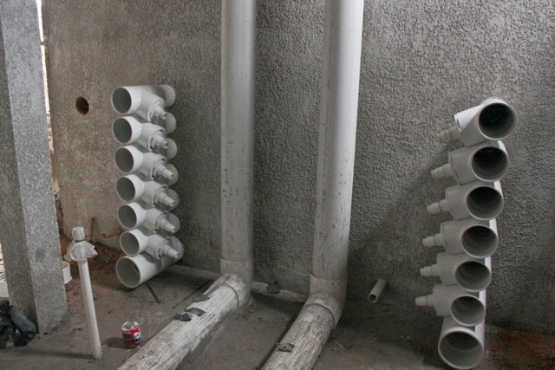
Backwash siphon
Backwash siphon

Slide 44


Slide 45


Slide 47
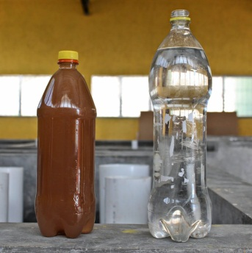
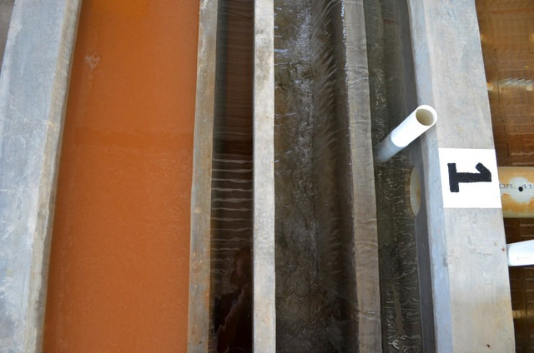
Flocculated water
entering the sedimentation tank
Settled water

Slide 48
Overview
How to Innovate and Design
The AguaClara Consortium
High-tech and Elegance
Pride of ownership
AguaClara technologies and plants
Philosophy and Reflections
Ctrl + click the pictures to go each section!

Slide 49
Three Key Ideas
AguaClara is open source engineering:
Many inventions, ZERO patents
Our technologies are described on our website and published in the literature.
Our example designs are available on the web!
Our technologies use ZERO electricity (except for batteries in the turbidimeters)
Our innovation is based on feedback and ongoing connections with plant operators

Slide 50
Resilience
We sometimes make the mistake of designing for steady state and forgetting about startup (NYC blackout in 1977
The USA has had stability for decades
Climate change is changing that
A breakdown in global trade could block replacement parts
Water supply is critical infrastructure and should be designed for resilience and rapid recovery after a disaster

Slide 51

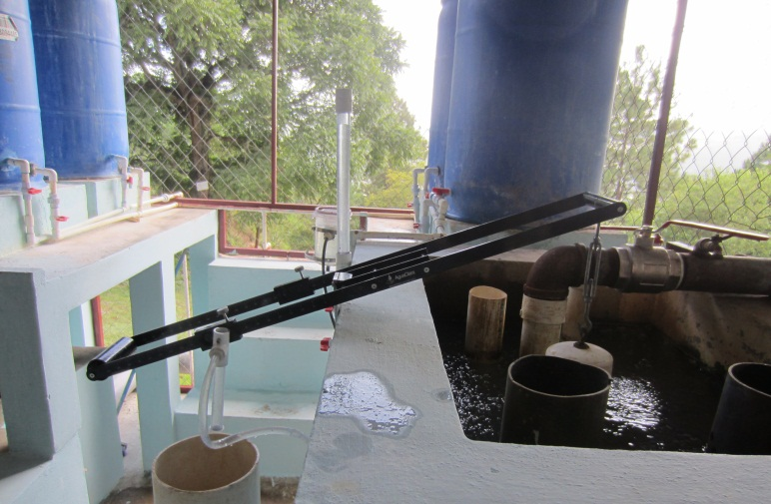
How Much Does it Cost?
*Quick and rough cost estimates.
Implementation COST
$100,000 + $8000 per L/s of capacity*
OPERATING COST
$5 per person per year
or $50 per million liters
ELECTRICITY COST
ZERO
Notes:
Quick and rough cost estimates.

Slide 52


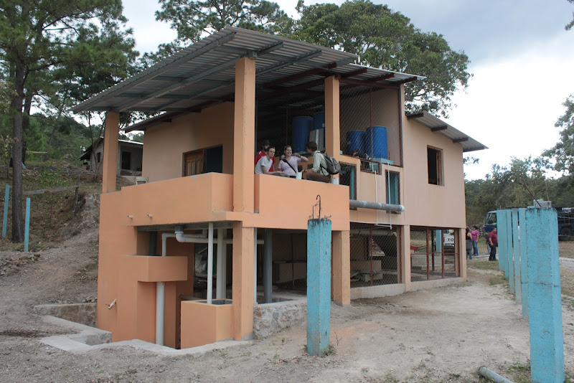
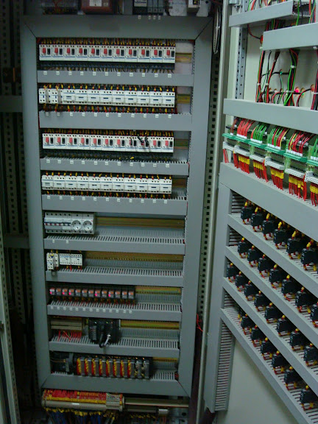
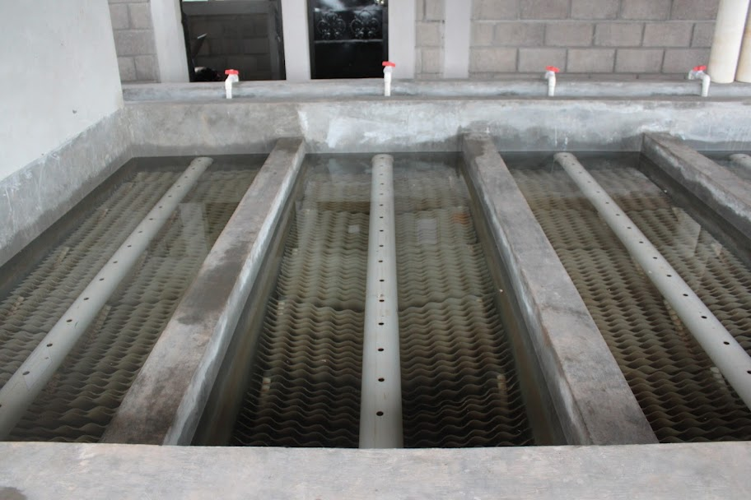
Reflections
Technology and Engineering Philosophy matter!
Infrastructure failures are linked to design choices
We design for Simplicity on the other side of Complexity

